Slide 1
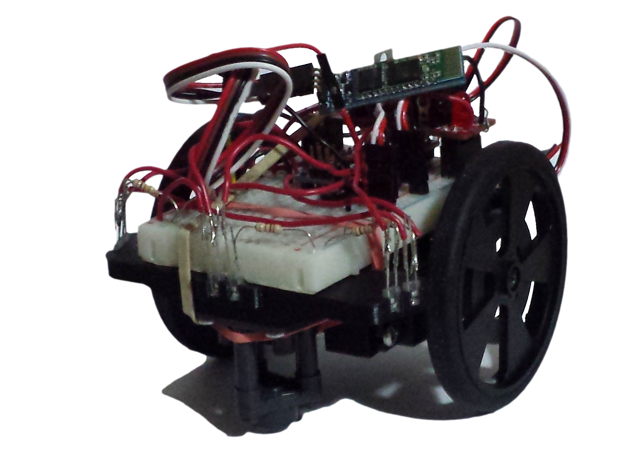
Nanomouse
Group Members: Jason Nixon, Mohammad Sameeh, Guillermo Fabian

Slide 2
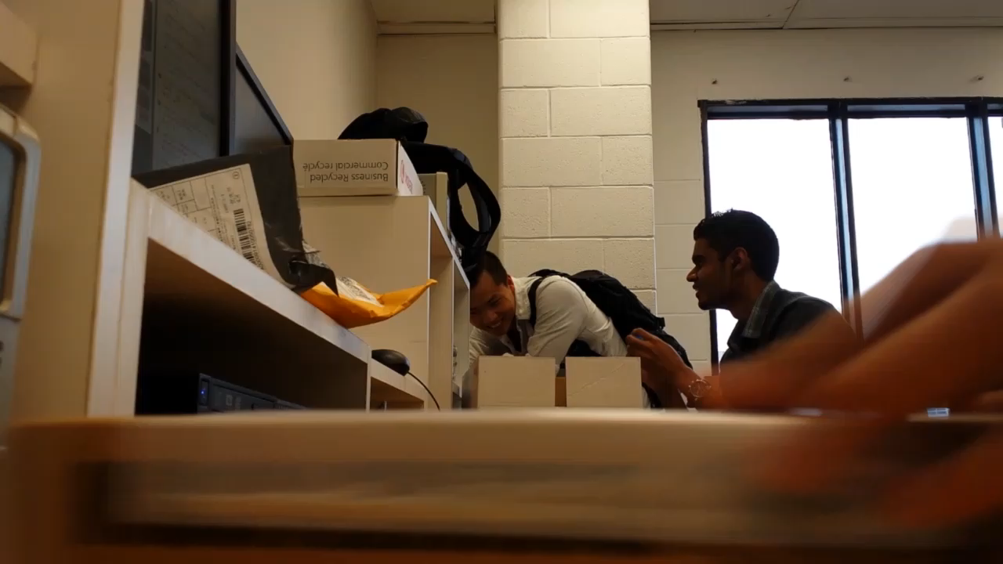
Introduction - Hardware Production

Slide 3
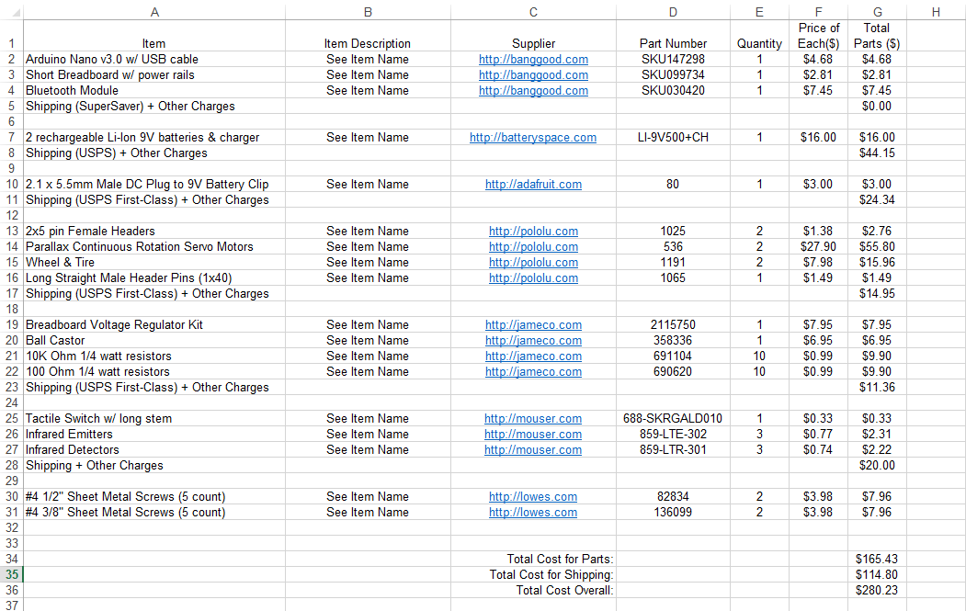
Project Bill of Materials

Slide 4
Algorithm – Schedule
January
Began researching Flood Fill Algorithm
February-March
Implementation of the Algorithm
April
Testing/Debugging code

Slide 5
Algorithm – Previous Courses
CENG 512 – Hardware Production
Soldering, scheduling projects.
CENG 510 – Algorithm & Data Structure in Java
Understanding algorithms. Its effectiveness.
CENG 302 – System Analysis
Documentation & Github.
TECH 101 – Electrical Circuits
Understanding & debugging circuits.
TECH 104 – Programming Fundamentals
Learning the basics of programming

Slide 6
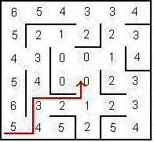

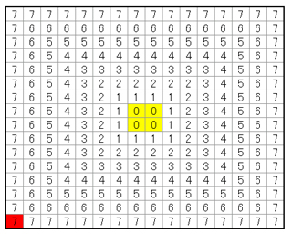
Algorithm – Flood Fill

Slide 7
Database – Project Schedule
January
Started to plan where to store my database
February-March
Implementation of the Database
April
Testing purposes

Slide 8
Database - Courses
CENG 415 – Database using Java Applications
Understanding the Database.
CENG 302 – System Analysis
Project Scheduling & Documentation.
CENG 512 – Hardware Production
Building the projects, and soldering
TECH 101 – Electrical Circuits
Understanding & debugging circuits.
TECH 104 – Programming Fundamentals

Slide 9
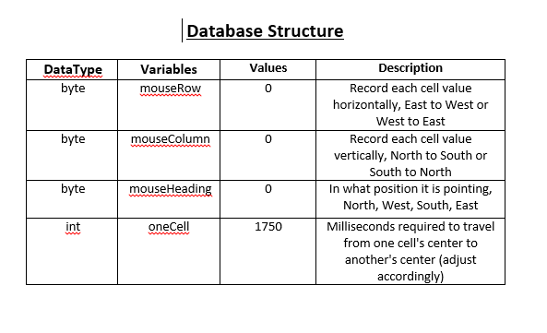
Database – Table

Slide 10
Application – Functionality
Functionality of the app:
The android device needs to be paired will the bluetooth module before starting the app
When the app is launched there will be start screen
At the controller screen there is a connect button that needs to be pressed to either pick a paired device or disconnect
Using the x-axis & y-axis of the device for steering and power
The values from the device will be received by the nano-mouse to control the speed of the motors
The direction of the device will determine the direction the nano-mouse will move

Slide 11
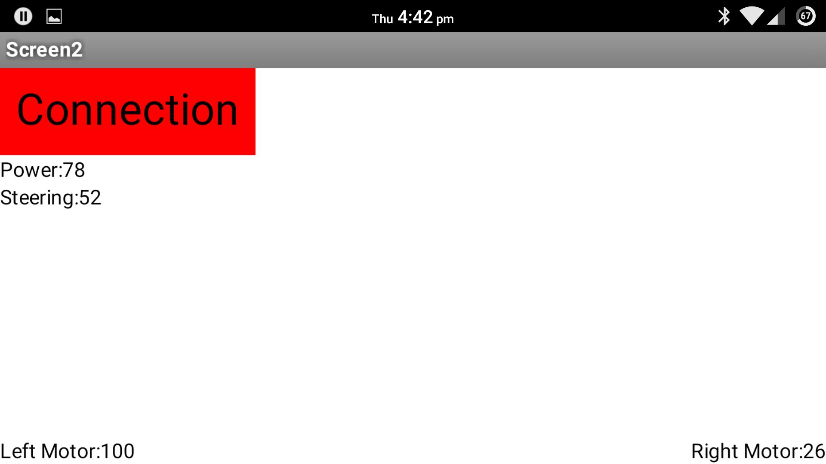
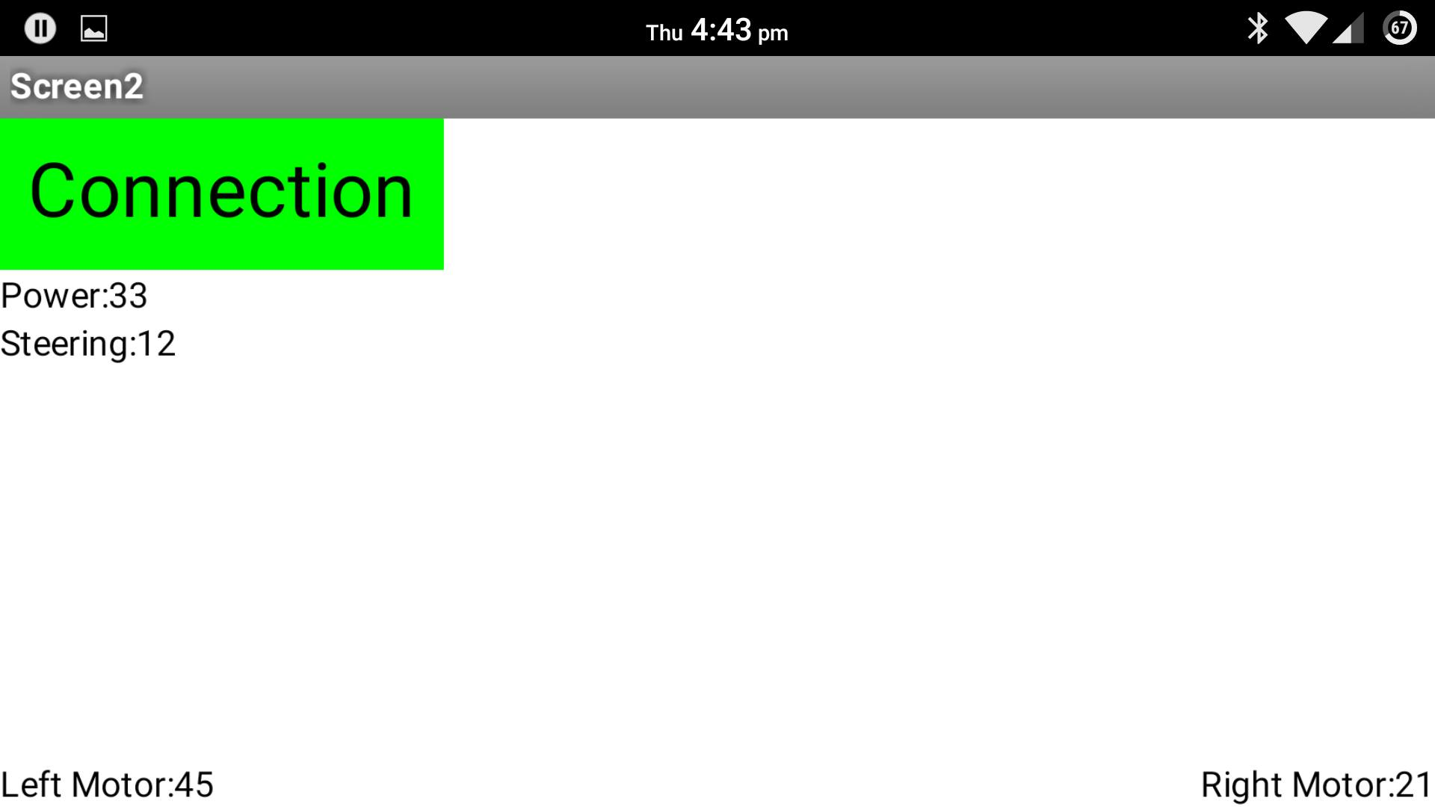
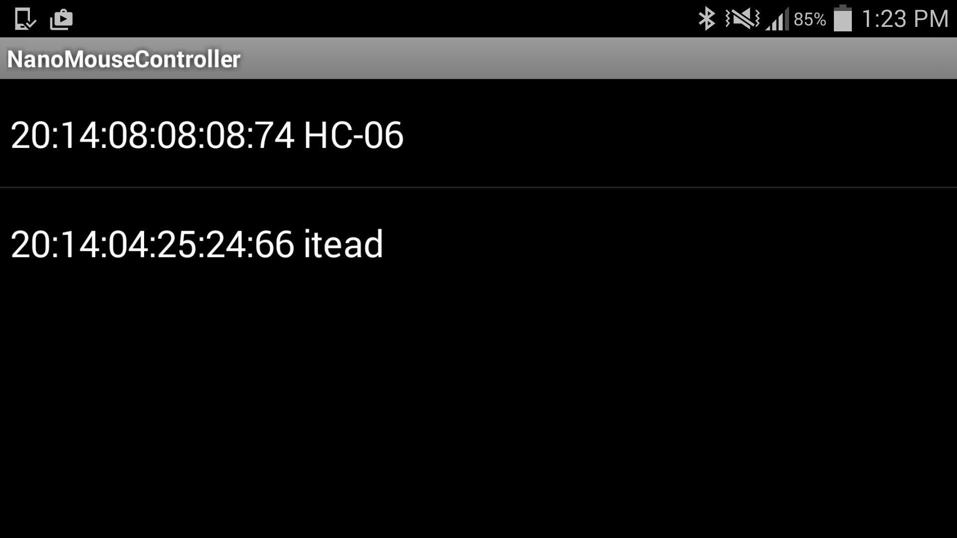
Application – App Screens

Slide 12
Application – Courses
CENG 512 – Hardware Production
Soldering the sensors and connecting bluetooth module
CENG 300 – Software Project
Create the app in app inventor
CENG 302 – System Analysis
Documenting on Github
CENG 310 – Programming Techniques in Java
* Understanding how to use App inventor
TMAT 120 – Tech Math 1
Solving the values to send to the nano-mouse

Slide 13

Conclusion

